Slide 1


A Presentation on M I R A
Presented by:-
John Subba
Sudeep Khadka
Kaustuv Baral

Slide 2
Contents
Introduction
Objective
Literature Review
Features
Block Diagram
Hardware Requirements
Software Requirements
Algorithms
Pre-Configuration Requirements
Circuit Diagram
Gantt Chart
Conclusion
References

Slide 3
Introduction
M-I-R-A stands for Micro-controller Integration by Radio-Frequency in Automation system.
8051 micro-controller will act as the processing component of the system.
It uses DTMF(Dual Tone Multi-Frequency) as input for controlling the appliances attached to the output of 8051.

Slide 4
Objective
To control electrical home appliances using cell-phones.
To detect and notify objects in the entrance passage(door).

Slide 5
Literature Review
Research on 8051 micro-controller based projects on websites such as nevonprojects, circuitstoday, lastminuteengineers etc.
DTMF technology(Dual Tone Multi- Frequency).
Home Automation Systems.

Slide 6
Features
Long Range of control (limited by the existence of cellular carrier cell towers).
Give command directly by calling to the sim number.
Receive Alert messages through the SMS.

Slide 7
Block Diagram
Phone
SIM800L
8051/52
MCU
Relay
driver
LIGHTS
FAN
AIR
COOLER
LCD
WATER
HEATER
RECORD
PLAYER
IR sensor

Slide 8
Hardware Requirements
8051/52 Micro-controller
SIM800L GSM Module
PCB/Breadboard and connecting wires
Infrared Sensor
LCD Display(16x2)
ULN2003A Relay Driver
3-4pcs (5v relay with plug and socket for 220v)

Slide 9
Software Requirements
Keil Compiler
Proteus 8 for simulation
Micro-Controller programming language – C/Embedded C

Slide 10
DTMF Technology
Used in touch tone phones, best known for sound made when pressing a number key.
It signals the phone company that you want to make call and send a command to the switch by sending 2 tones(1 high and 1 low) for each number pressed.

Slide 11
Frequency Chart
F2 F1 | 1209 Hz | 1336 Hz | 1477 Hz
697Hz | 1 | 2 | 3
770 Hz | 4 | 5 | 6
852 Hz | 7 | 8 | 9
941 Hz | * | 0 | #

Slide 12
Algorithm
Step 1: Start.
Step 2: Supply the power to the system.
Step 3: Configure phone-number for DTMF based control.
Step 4: Wait for call in sim module and activate as per the desired extension number for start/stop various loads.
Step 5: Display in LCD relevant messages.
Step 6: Monitor for IR Sensor input.
if input notify user via SMS, else goto step 4.
Step 7: Stop.

Slide 13
Pre-Configuration Requirements
Automatically pick any incoming call after 1 ring.
Enable DTMF decoder in SIM800 (AT command data sheet for parameters).
Listen for incoming DTMF values on the serial connection.
Programmed dial pad numbers:
1 for turning ON relay 1 and 2 for turning OFF relay 1.
3 for turning ON relay 2 and 4 for turning OFF relay 2.
5 for turning ON relay 3 and 6 for turning OFF relay 3. and so on...

Slide 14
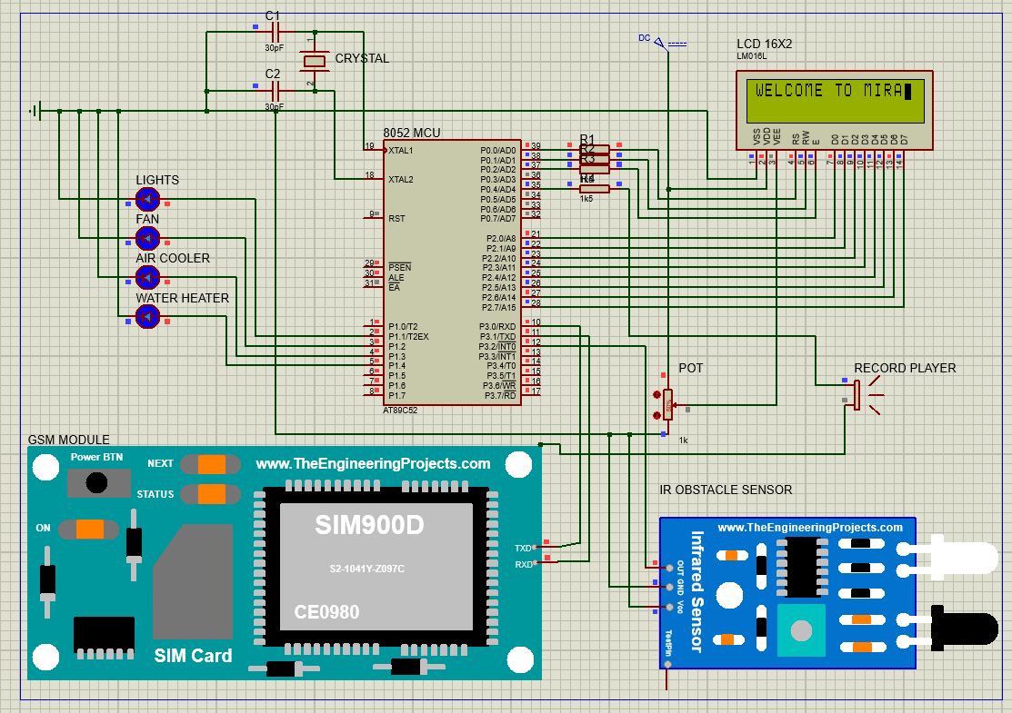
Circuit Diagram

Slide 15
Gantt Chart
Task | January | February | March |  | April |  | May | June
Requirement gathering & analysis
Hardware selection & configuration
Database design and implementation
UID & Java Prrogramming
Testing and debugging
Documentation

Slide 16
Conclusion
M-I-R-A is a system aimed to utilize the cell phones to control it with minimal or no physical human effort to On/Off the appliance switch as well as monitor surrounding environment using various sensors.

Slide 17
Reference
Muhammad Ali Mazidi et al.(Oct 01, 2022). The 8051 Microcontroller and Embedded Systems.
Nevon Projects (Oct 10, 2022). Digitally controlled home automation projects. https://nevonprojects.com/digitally-controlled-home-automation-project/
Last Minute Engineers (Oct 20,2022). Send Receive SMS & Call with SIM800L GSM Module & Arduino. https://lastminuteengineers.com/sim800l-gsm-module-arduino-tutorial/

Slide 18
Any Questions/Queries?
THANK YOU!

